Slide 1

Ramrao Adik Institute of Technology
Department of Computer Engineering
TE Mini Project-IV
PlateMaster
By
Roll No. Name of Students
21CE1004
21CE1021
21CE1020
21CE1395
Ashish Sahu
Aman Sahay
Amit Javkar
Sujal Pokharkar
Mr. Gaurav Datkhile

Slide 2
Index
Introduction
Literature Survey
Problem Statement
Proposed methodology
System design
Hardware and software requirement
Results and Discussion
Conclusion and future work
References

Slide 3
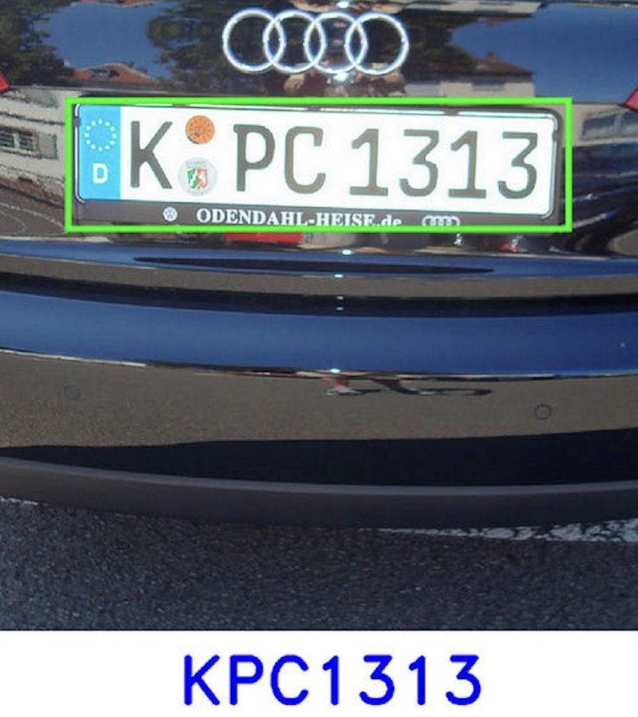
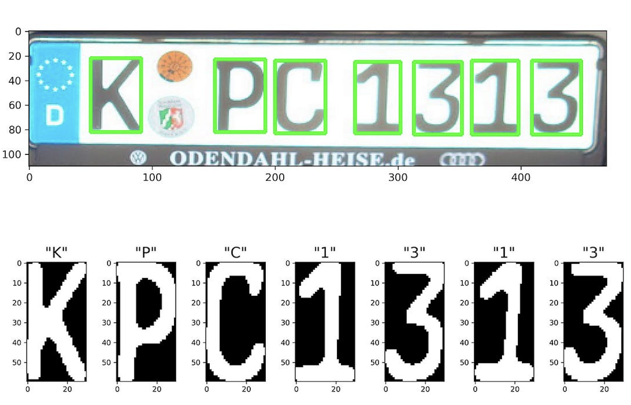
Introduction
Topic: PlateMaster
The PlateMaster is a Number Plate Detection System designed to identify and track vehicles by license plates.
Image recognition algorithms and camera systems, this innovative solution enhances security and facilitates efficient monitoring of traffic flow.
By detecting vehicles lacking proper identification, it aids law enforcement in addressing potential violations and contributes to overall public safety.

Slide 4
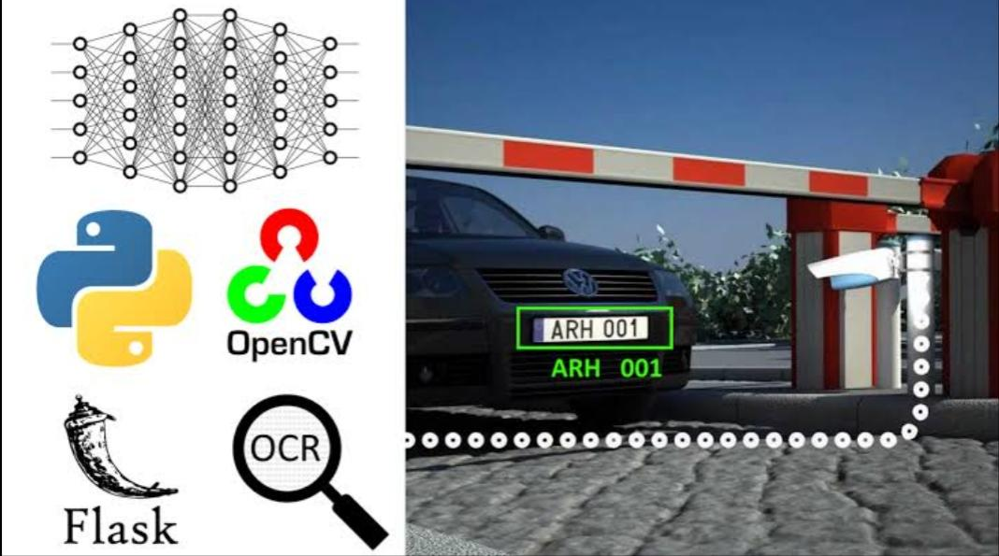
Introduction
Image recognition algorithms and camera systems, this innovative solution enhanced.

Slide 5
Literature Survey
The development of a Vehicle Entry System aimed at efficiently managing and regulating vehicle entry into a specified area
Traffic management strategies are a significant focus, with research exploring queue management techniques, dynamic routing algorithms, and scheduling mechanisms to optimize traffic flow and minimize congestion at entry points.
Security measures play a crucial role in the development of vehicle entry systems, with studies investigating access control protocols, intrusion detection.
User Experience and Interface Design: One critical aspect of vehicle entry systems is the user interface and overall user experience. Research in this area delves into designing intuitive interfaces for drivers.
Environmental Impact and Sustainability: Another important dimension of vehicle entry systems is their environmental impact and sustainability

Slide 6
Problem statement
The project aims at creating an innovative vehicle entry system to tackle current hurdles in accurately identifying and monitoring vehicles across diverse environmental scenarios. Existing systems face issues with inconsistent license plate recognition, which jeopardizes security measures. The integration of numerous components leads to intricate systems, presenting maintenance and interoperability obstacles. This project seeks to utilize cutting-edge object detection, tracking, and image processing methodologies to enhance vehicle detection and license plate recognition accuracy, especially in demanding conditions. Priority will be given to scalability, efficiency, and straightforward maintenance to facilitate smooth deployment and operation within real-world transportation settings.

Slide 7
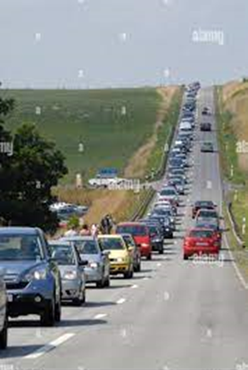
Proposed methodology
Queue Management Techniques: Efficient queue management is essential for smooth operation of vehicle entry systems, particularly during busy times. A common approach is First-In-First-Out (FIFO), serving vehicles in the order they arrive. To boost efficiency, modifications such as introducing priority lanes for emergency vehicles or pre-registered users can be made. Moreover, advanced algorithms like Shortest Queue or Dynamic Queue Adjustment can be tailored to allocate lanes dynamically based on live traffic data, reducing wait times and increasing overall system throughput.

Slide 8
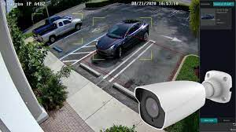
Proposed methodology
2. Surveillance Technologies: Surveillance technologies, including CCTV cameras and motion sensors, are integral for monitoring vehicle entry points and detecting potential security threats. Customizations may involve the integration of advanced video analytics algorithms, such as object detection and behavior recognition, to enhance the accuracy and efficiency of threat detection.

Slide 9
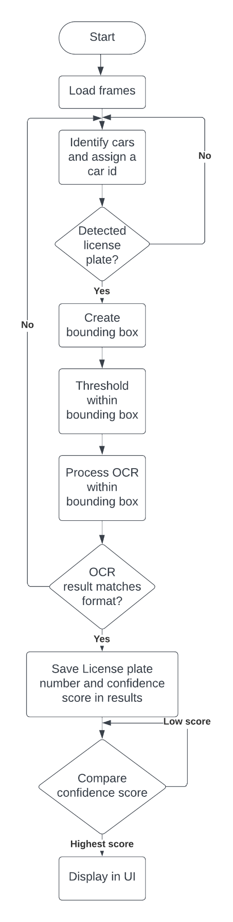
System Design

Slide 10
System Design
Flow chart

Slide 11
Hardware and software requirements
Windows 10 and after
Nvidia Graphics card
8 Gb RAM
Intel or AMD Processor
Tensorflow
Python
Appropriate dataset
Pandas
Pytorch
Easy OCR Framework
OpenCV

Slide 12
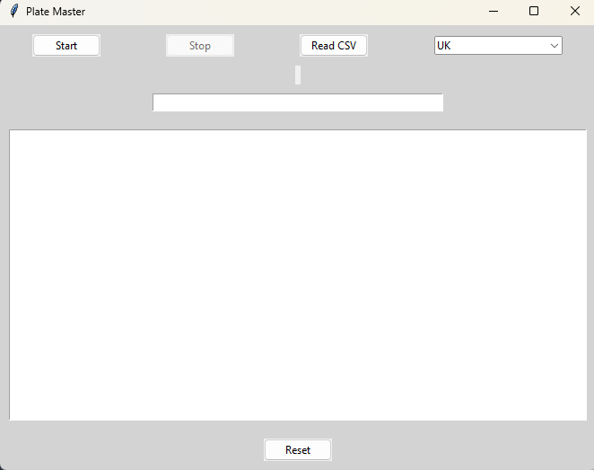
Result and Discussion
This image shows the UI of Plate Master

Slide 13
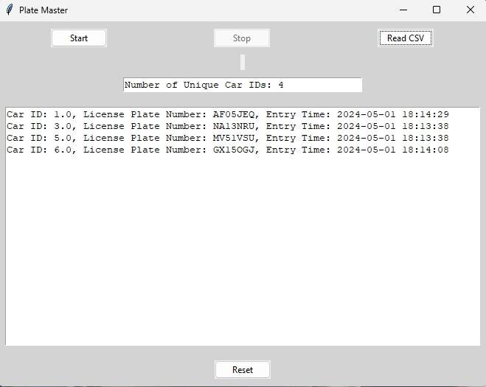
Result and Discussion
This image shows the UI displaying the Result of the plate detection process

Slide 14
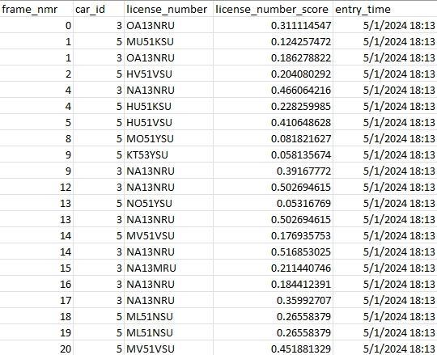
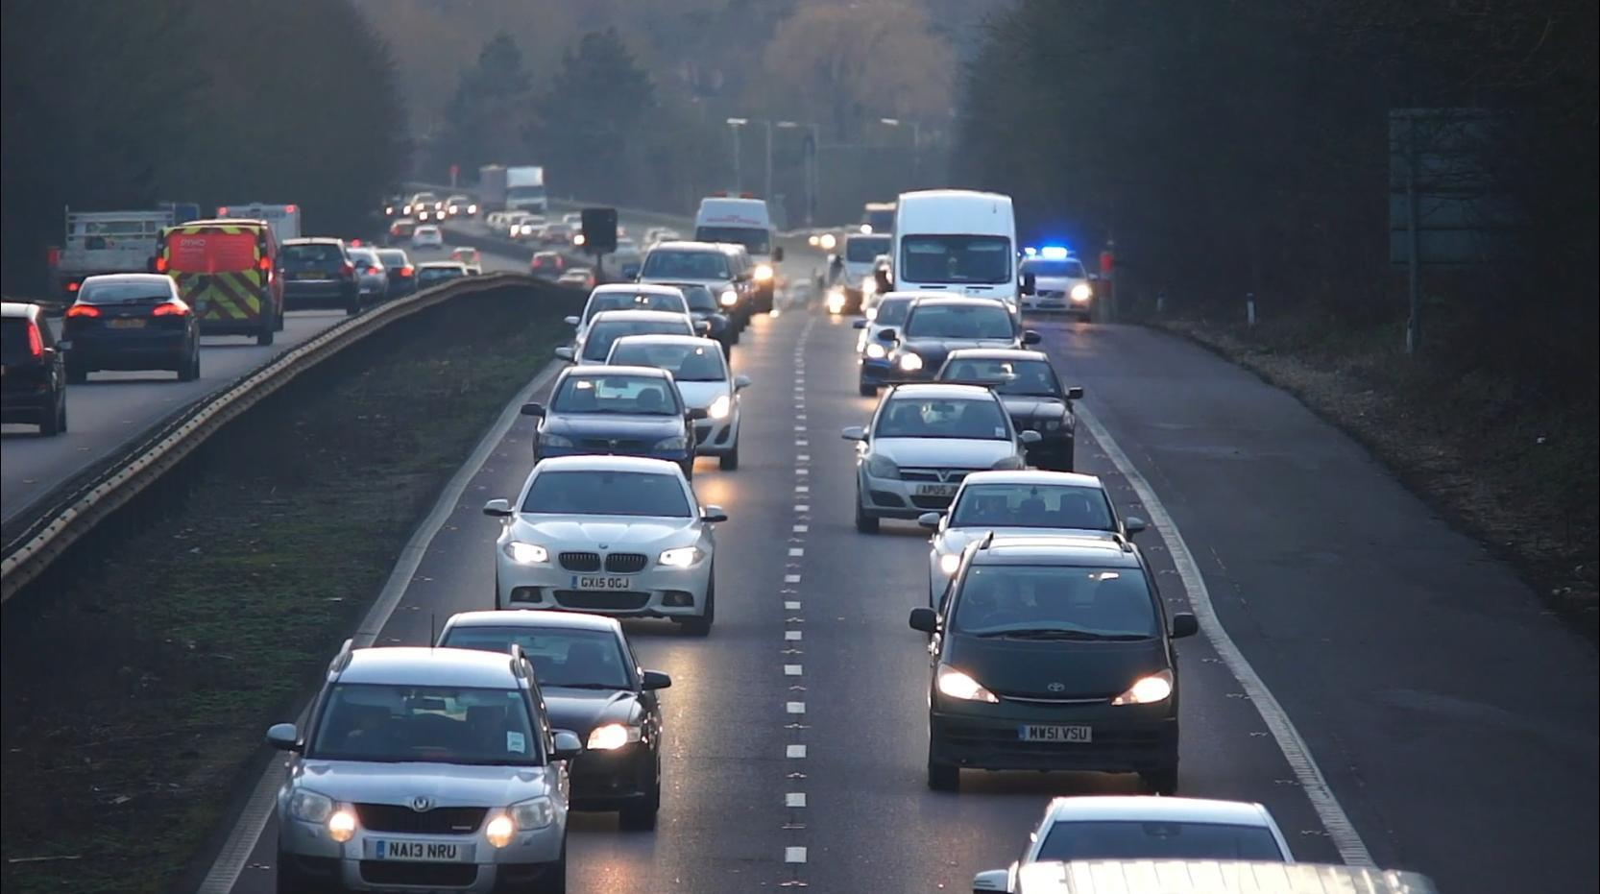
Result and Discussion
Image shows a frame from the sample video
This image shows the result of the OCR process in CSV file

Slide 15
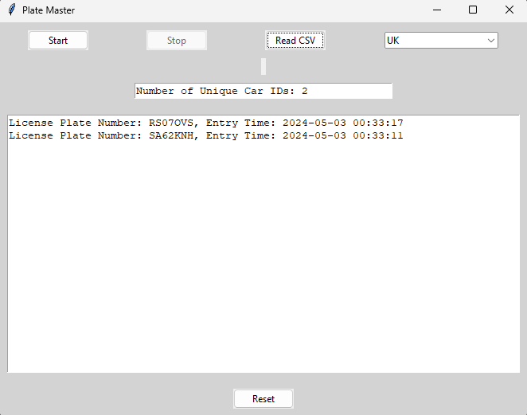
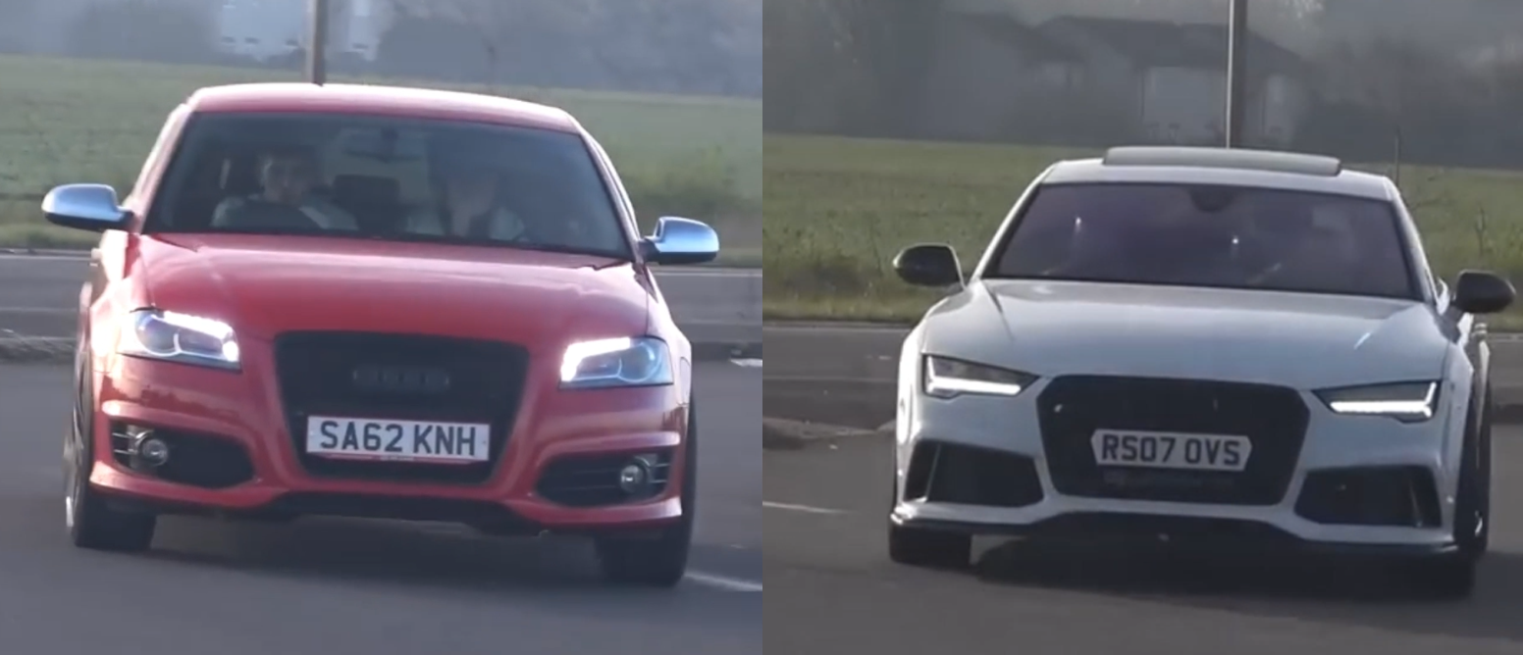
Result and Discussion
Image shows a frame from the sample video
This image shows the UI displaying the Result of the plate detection process

Slide 16
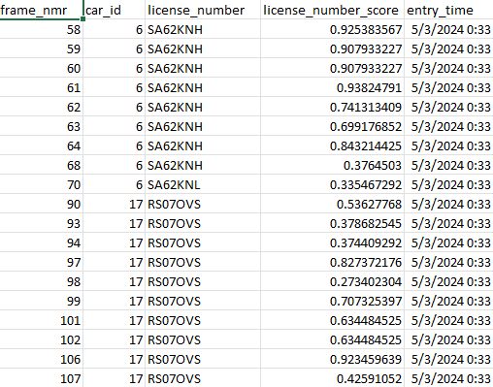
Result and Discussion
This image shows the result of the OCR process on another video in CSV file

Slide 17

Result and Discussion
This image shows the UI being set to India

Slide 18
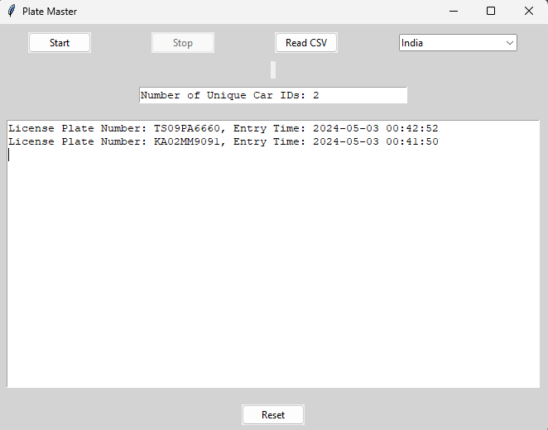
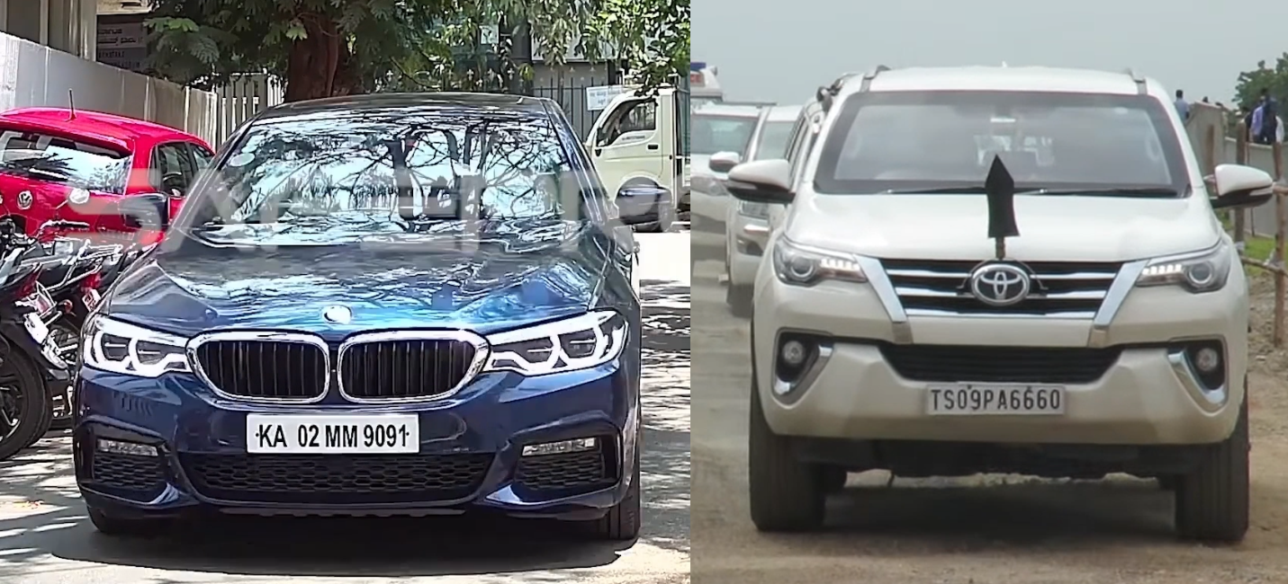
Result and Discussion
A clip of the video is as above, these license plates are detected as shown in UI
This image shows the UI displaying result of the plate detection process on a Indian
video

Slide 19
Conclusion and future work
The development and exploration of vehicle entry systems mark a pivotal advancement in the field of transportation management and security surveillance. Throughout this project, we have highlighted the significance of accurate vehicle detection, tracking, and license plate recognition in enhancing traffic flow, improving security measures, and streamlining entry management processes.
By leveraging large datasets and advanced learning algorithms, future iterations of vehicle entry systems can achieve higher levels of accuracy and reliability in license plate recognition, thereby enhancing security measures and facilitating seamless entry management processes. Additionally, the incorporation of emerging technologies such as and sensor fusion holds promise for enhancing the efficiency of vehicle entry systems. By addressing current limitations and exploring new avenues for improvement, future iterations of vehicle entry systems have the potential to revolutionize transportation management, ushering in a new era of efficiency on our roads and in our communities.

Slide 20
References
GitHub - NanoNets/nanonets-ocr-sample-python: NanoNets OCR API Example for Python
How to detect license plates using OpenCV Python?
OpenCV: Automatic License/Number Plate Recognition (ANPR) with Python - PyImageSearch
vjgpt/Vehicle-Number-Plate-Reading
Sergio Montazzolli Silva and Claudio Rosito Jung. License plate detection and recognition
in unconstrained scenarios. In Proceedings of the European Conference on Computer
Vision (ECCV), September 2018.
Wang Weihong and Tu Jiaoyang. Research on license plate recognition algorithms based
on deep learning in complex environment. IEEE Access, PP:1–1, 01 2020. Wikipedia contributors. Automatic number-plate recognition.
Wengang Zhou, Houqiang Li, Yijuan Lu, and Qi Tian. Principal visual word discovery for
automatic license plate detection. IEEE Transactions on Image Processing, 21(9):4269–

Slide 21
Thank You

